Slide 1
For this commandment which I command you today is not too mysterious for you, nor is it far off. It is not in heaven, that you should say, “Who will ascend into heaven for us and bring it to us, that we may hear it and do it?” Nor is it beyond the sea, that you should say, “Who will go over the sea for us and bring it to us, that we may hear it and do it?” But the word is very near you, in your mouth and in your heart, that you may do it (Deut. 30:11-14).
All Scripture is taken from the New King James Version®. © 1982 by Thomas Nelson, Inc. Used by permission. All rights reserved.

Slide 2
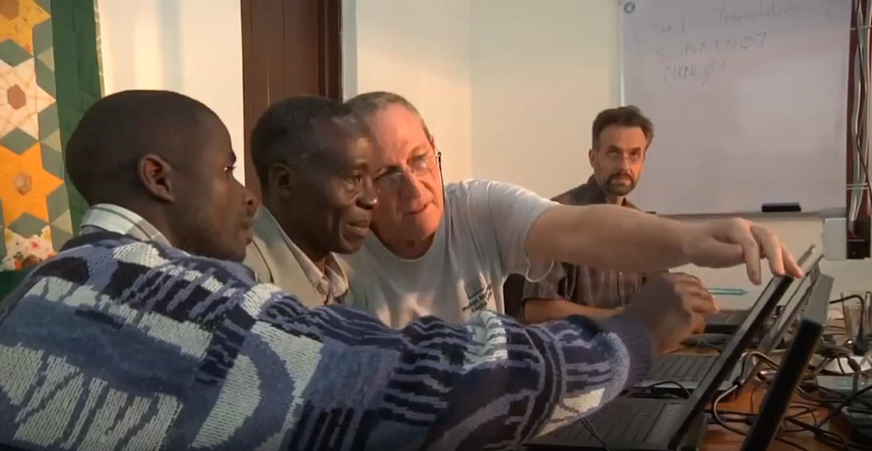
Wycliffe Associates

Slide 3
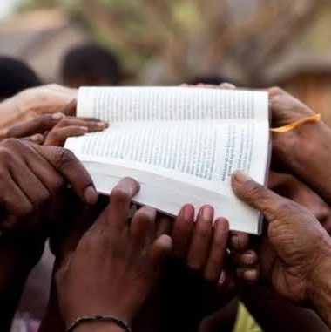
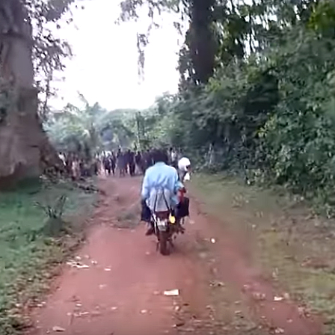
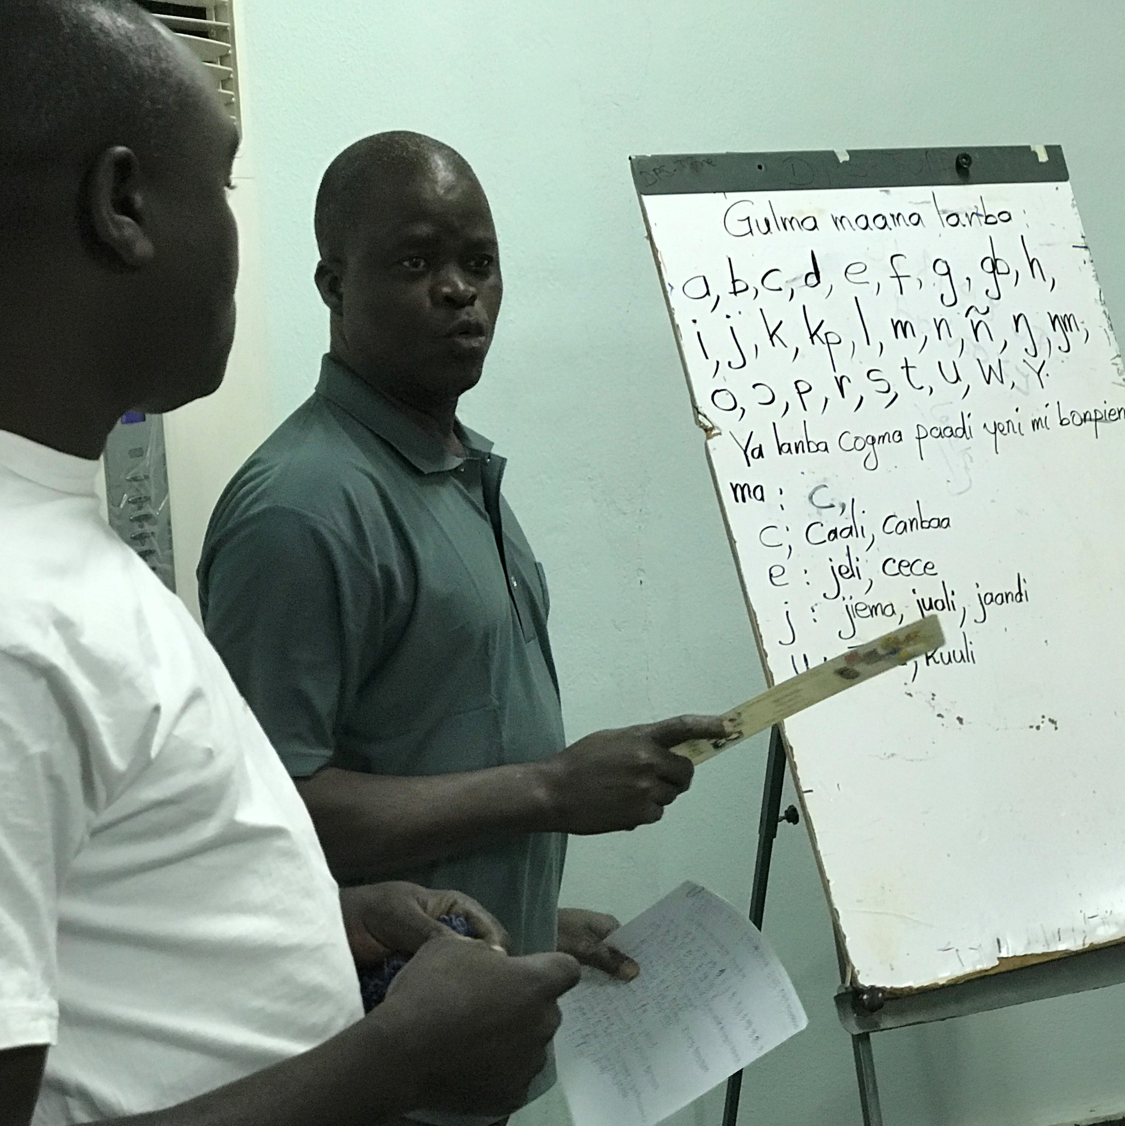
?

Slide 4
Wycliffe Associates History Why?
Wycliffe Associates was established in 1967
Purpose was to provide practical assistance to translators globally
Allowed Translators to focus on Bible translation work

Slide 5
Wycliffe Associates History How?
Volunteers offered a wide range of skills to assist Bible translation work globally
Administration
Construction
Maintenance
Technology
Infrastructure
Translators could focus on Bible translation rather than other activities

Slide 6
Wycliffe Associates History Urgent Need Called for a New Solution
In 2014, Wycliffe Associates developed and tested a new Bible translation method
MAST—Mobilized Assistance Supporting Translation.
MAST equips national translators to quickly translate the Bible clearly and accurately
The local church has a central role

Slide 7

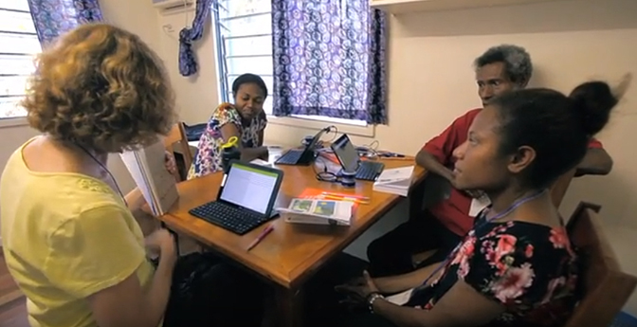
2014
First MAST translation event
Mother-tongue translators trained in this new method

Slide 8

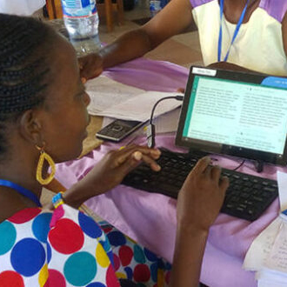

Focus shifted to training translators in MAST method
Now providing free, open-license resources to translators around the world

Slide 9

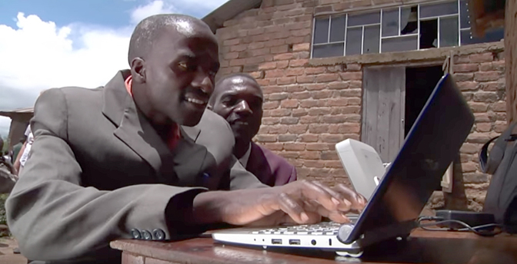
VISION:
A Bible in Every Language
Advancing Church-Owned Bible Translation through free training and tools
2 Corinthians 9:6–15
Matthew 28:19–20

Slide 10
2 Corinthians 9:6-15
But this I say: He who sows sparingly will also reap sparingly, and he who sows bountifully will also reap bountifully. ⁷ So let each one give as he purposes in his heart, not grudgingly or of necessity; for God loves a cheerful giver. ⁸ And God is able to make all grace abound toward you, that you, always having all sufficiency in all things, may have an abundance for every good work. ⁹ As it is written:
“He has dispersed abroad, He has given to the poor; His righteousness endures forever.”

Slide 11
2 Corinthians 9:6-15 continued
¹⁰ Now may He who supplies seed to the sower, and bread for food, supply and multiply the seed you have sown and increase the fruits of your righteousness, ¹¹ while you are enriched in everything for all liberality, which causes thanksgiving through us to God. ¹² For the administration of this service not only supplies the needs of the saints, but also is abounding through many thanksgivings to God, ¹³ while, through the proof of this ministry, they glorify God for the obedience of your confession to the gospel of Christ, and for your liberal sharing with them and all men, ¹⁴ and by their prayer for you, who long for you because of the exceeding grace of God in you. ¹⁵ Thanks be to God for His indescribable gift!

Slide 12
Matthew 28:19-20
Go therefore and make disciples of all the nations, baptizing them in the name of the Father and of the Son and of the Holy Spirit, ²⁰ teaching them to observe all things that I have commanded you; and lo, I am with you always, even to the end of the age.” Amen.

Slide 13
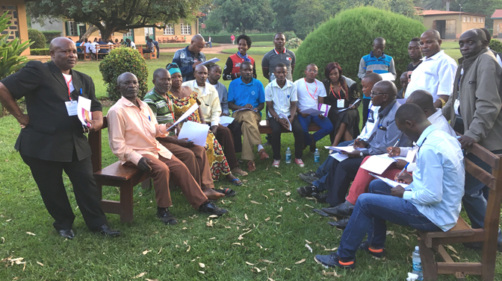
Committed to serving the local church, partnering to reach every language with Bible translation

